Slide 1
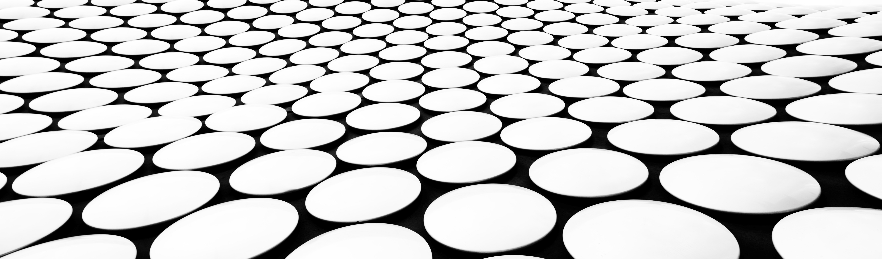
IT News in the world today
Presentation by: Group 6

Slide 2
Presenters
Brandon | Photoshop on IPhone
Landon | Microsoft’s Majorana 1 Chip
Cameron | UK copyright sell-out to AI

Slide 3
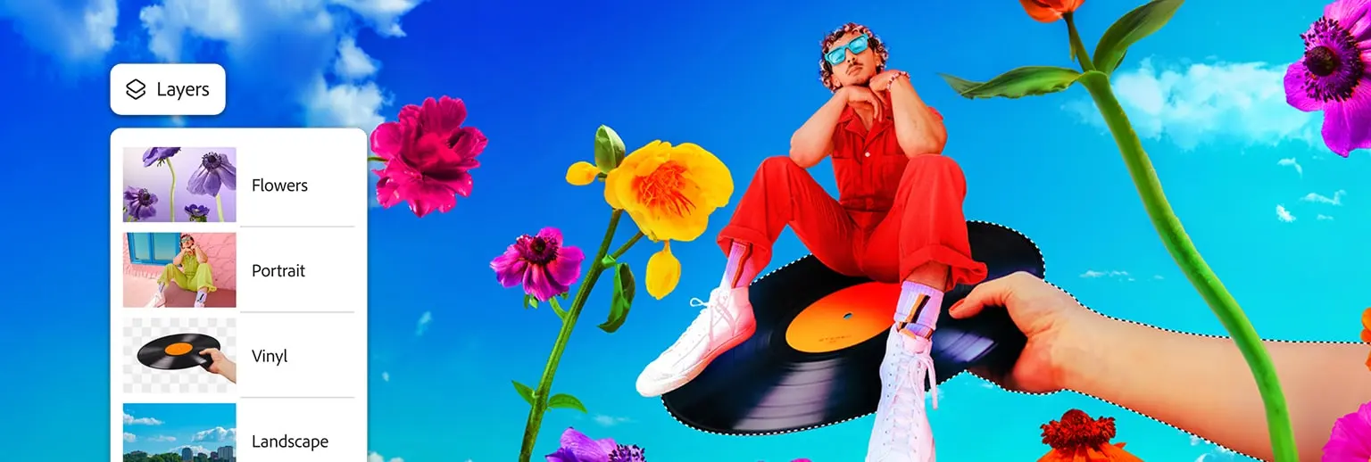
Photoshop on iphone
Presenter: Brandon Maloney

Slide 4
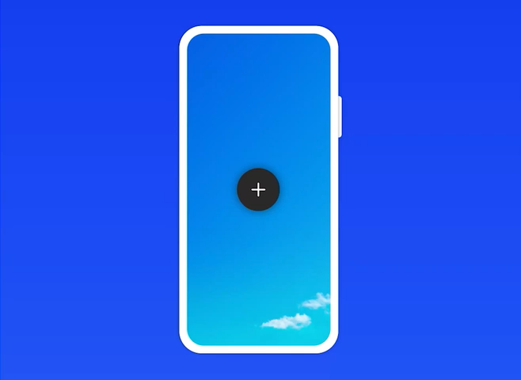
Photoshop on iphone
Free to download
Offers core Photoshop tools like selections, layers, masks, and more.
Generative AI
Features like Generative Fill and Generative Expand for creating and modifying images.
Adobe Stock Integration
Access free assets and link with other Adobe apps (Express, Lightroom, Fresco).
Premium Features
Includes advanced AI tools, 20,000 fonts, object isolation, and more.
Web & Mobile Sync
Transition between mobile and web versions of Photoshop for precise editing.

Slide 5
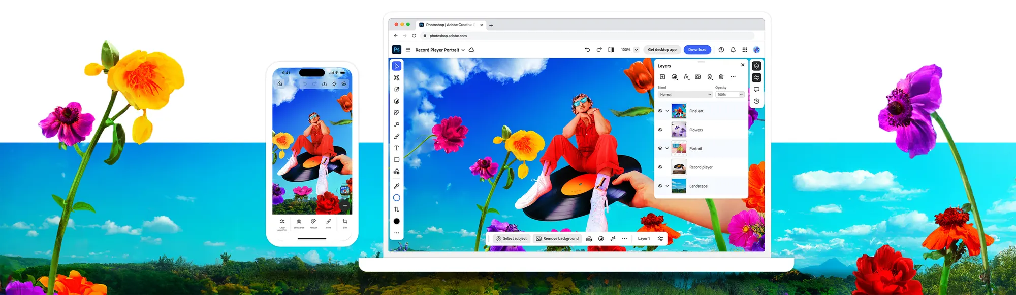
Accessibility
Photoshop has never been easier to access now that it’s free and on mobile devices, any vision you have can now be created on the fly—no subscription required. It’s perfect for anyone who wants to get creative without the barrier of a paid plan.

Slide 6
Microsoft’s Majorana 1 Chip
Presenter: Landon lewis

Slide 7
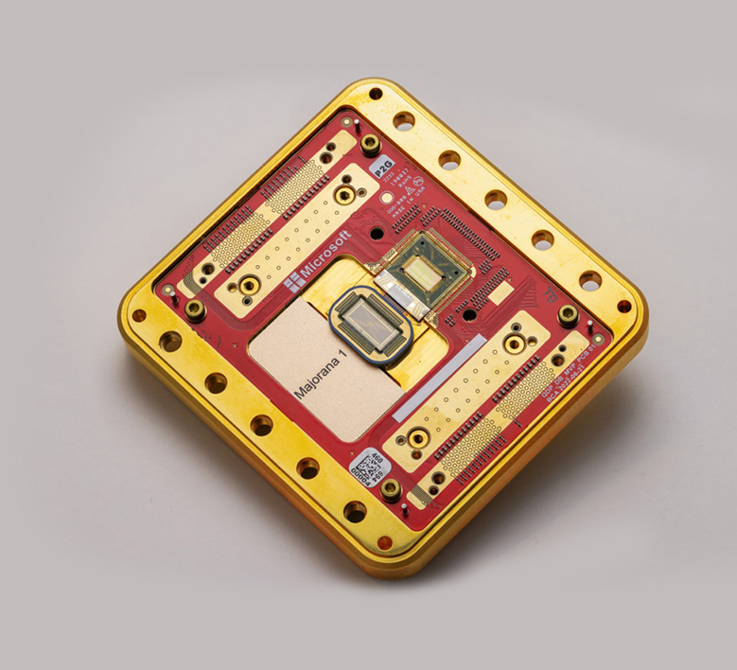
What is the Majorana 1 chip?
The Majorana 1 chip is a quantum computing chip made by Microsoft.
This quantum chip is the world’s first that is powered by a Topological Core.
With this, the chip uses a topoconducter, a material used to observe and control Majorana particles.
It is used to calculate complex problems and is said to be able to do it faster than any other quantum chip.

Slide 8
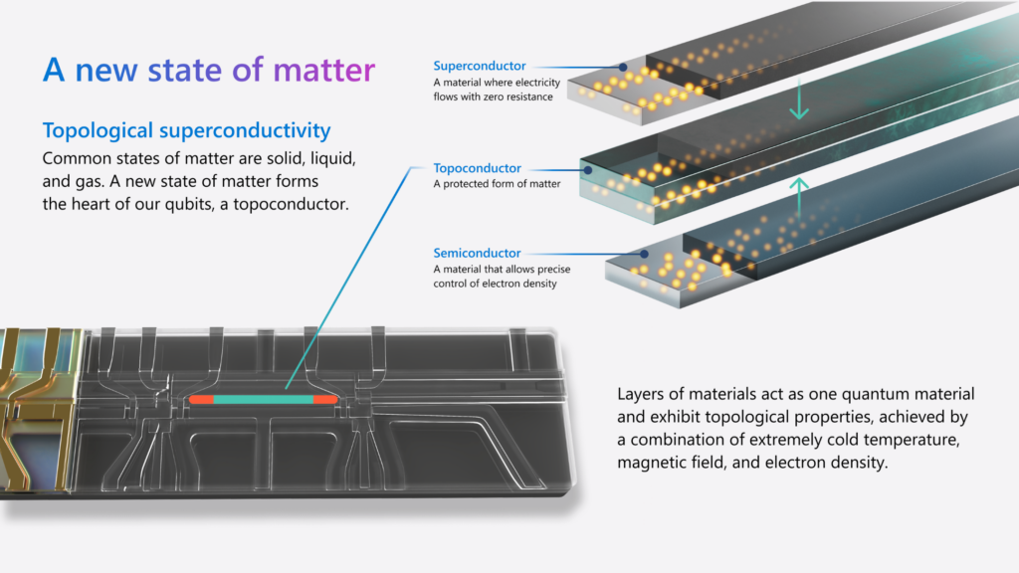
What makes the Majorana 1 chip such a breakthrough for quantum computing
The Majorana 1 chip was made using a topoconducter. The topoconducter, also known as a topological superconductor is a special category of material. So special that it can create a whole new state of matter. As we all know the states of matter are solid, liquid, gas, and plasma. However, this new state of matter is a topological state. Qubits are the main units for info in quantum computing. This new topological state of matter can be used to make more stable and fast qubits, creating topological qubits. Which means that problems that would take decades to solve with quantum computing, could be solved in just a few years.

Slide 9

the UK copyright sell-out to AI
Presented By
Cameron Boyer

Slide 10
What the UK proposed
The U.K. proposes to change copyright laws that would allow AI developers to train models on artists’ content without permission or payment to those artists.
This means AI companies can take any piece of art or music available on the internet (copyright protected or not) and use it to train their AI models.
This brings debate over what is more important,
Innovation or creator protection.

Slide 11
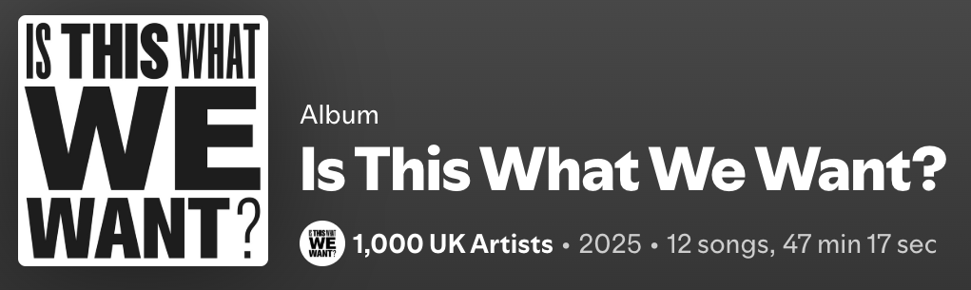
What artists are doing in protest
1,000 UK Artists have released a 12-track album consisting of not music, but the sound of their empty studio spaces.
This shows that if AI is used to produce the music or art we consume, artists will slowly become obsolete.
It is also showing that artists will stop releasing music, if what they release is considered free use to AI companies.

Slide 12

Thank you for listening to our presentation
Have a great day!

